Slide 1
Elite Data Hacks
Christopher Josef, MD

Slide 2
OUTLINE
SEPY
History
Overview
Yearly
BMI Operations
BMI Cluster
VPN/Big Edge IP Client
SSH
Screen
SLURM

Slide 3
SEPY History
flat files
SEPY is a python toolkit for binning hourly inpatient data and calculating an hourly Sepsis-3 time
The intent is to standardize the process so it could be replicated across multiple sites with relative ease
Currently executed on Emory and Grady patient cohorts
Ultimate output is a single python class object that contains a robust collection of patient features
Demographics
Encounters
Lab Values
Medications
Vitals
GCS
SEPY Pipeline
Cultures
Bed Locations
Procedures
encounter.pickle
Demographics
Labs
Vitals
Sepsis Label
Etc.
Diagnoses
Vent
Single file per encounter

Slide 4
Overview
Where Can Data Be Found?
Home Directory- private; storage limit
Rishi Lab Directory (root)- large storage, ?Maybe faster in connection w/ cluster
MODS Folder:
Folder Name | Contents
1. Encounter_Pickles | 1. processed patient data 2. summary reports
2.Data | 1. Original flat files from Emory & Grady(pipe delimited) 2. Shamim MatLab results
3.EliteDataHacks | Scripts for: SLURM, BASH, and Python Patient lists for Emory/Grady Grouping Files
4.Environments | 1. A virtual environment called “SOFA_calcs” (What CSJ uses to when he’s on the cluster) * Use this environment or make your own; just don’t keep it in your home directory
5.Visualization | 1. CSJ made some plots of SOFA score w/ sepsis using a beta python script
6.Yearly_Pickles | 1. A collection of pickles. Each pickle file represents a year’s worth of data for Grady or Emory
7.Archive | Old files that should probably be deleted

Slide 5
Work Flow
Database Extraction
flat files are saved somewhere not on the cluster
File Consolidation
Flat files moved to MODS folder in Rishi’s lab
Yearly Pickles Pipeline converts flat files into yearly pickles
Encounter Pickles
create pickle for each encounter
?OneDrive
2.Data
6.Yearly_Pickles
1.Encounter_Pickles

Slide 6
Yearly Pickle Code Execution
SLURM
- Requests ~7 cpu’s and ~25GB RAM
- Calls make_pickle
Python Coordinator
- Has location of all flat files
- Calls sepyIMPORT
sepyIMPORT
- Takes flat files and converts them into a single pickle for the whole year

Slide 7
Pipeline
Instantiate Class: sepyIMPORT
csv
csv
Instantiate Class: sepyDICT
y18.pickle
enc1
Pt1.pickle
Each instance is the data for 1 enc
pt2
Pt2.pickle
pt3
Pt3.pickle
Pickle has all 2018 pt data (i.e. it’s big)

Slide 8
Encounter Code Execution
SLURM
- Requests ~16 cpu’s & ~50GB RAM
- Calls make_dicts.py
Python Coordinator
- Calls sepyDICT & passes the following:
sepyDICT
- Creates a single patient pickle for each encounter
Year, list of Encounter #’s, Location of yearly pickle, Total number of CPU’s, CPU assignment

Slide 9
make_dicts.py
List of patients
sepyDICT.py
em_y18.pickle
123456.pickle
encounter_summary.csv
make_dicts.py
SIRS_summary.csv
556644.pickle
em_y19.pickle
sepsis2_summary.csv
778899.pickle
SOFA_summary.csv
em_y20.pickle
sepsis3_summary.csv
error_summary.csv
Total Processes
Process #

Slide 10
Patient Dictionary Hierarchy:
Need to Update
6/25
csn: 123456 (large int) [encounters]
flag: (dictionary)
static_features: (dictionary)
even-t_times: (dictionary)
culture_times: (data frame)
abx_staging: (data frame)
super_table: (data frame)
vitals_staging: (data frame)
gcs_staging: (data frame)
labs_staging: (data frame)
vasopressor_staging: (data frame)
vent_staging: (data frame)
bed_location: (data frame)
diagnosis: (data frame)
procedures: (data frame)
sirs_times: (data frame)
sofa_scores: (data frame)
sofa_times: (data frame)
suspicion_times: (data frame)
sep2_time: (list)
sep3_time: (data frame)
ase_time: (list)
staging data frames
field name: example value ( data type) [file name] filter or grouping

Slide 11
flags (dictionary)
Need to Update
6/25
Description:
Flags necessary for cohort creation
flag
csn | 123456 | (big_int) | [?]
pt_id | Z56465 | (str) | [?]
y_vent_rows | 0 | (boolean) | [?]
y_vent_start_time | 1 | (boolean) | [?]
y_vent_end_time | 0 | (boolean) | [?]
vent_start_time | 0 | (boolean) | [?]
ed_wait_time | 1 | (date_time) | [?]
first_sep2_susp |  | (date_time) | [?]
first_sep2_SIRS |  | (date_time) | [?]
first_sep2_time |  | (date_time) | [?]
first_sep3_susp |  | (date_time) | [?]
first_sep3_SOFA |  | (date_time) | [?]
irst_sep3_time |  | (date_time) | [?]
first_sep3_susp_mod |  | (date_time) | [?]
first_sep3_SOFA_mod |  | (boolean) | [?]
first_sep3_time_mod |  | (boolean) | [?]

Slide 12
event_times (dictionary)
Need to Update
6/25
Description:
Key event times
event_times
ed_presentation_time |  | (date_time) | [?]
hospital_admission_date_time |  | (date_time) | [?]
hospital_discharge_date_time |  | (boolean) | [?]
start_index |  | (date_time) | Is earlier of ed_presentation and hospital admission
first_icu_start |  | (date_time) | [?]
first_icu_end |  | (date_time) | [?]

Slide 13
static_features (dictionary)
Description:
Patient & encounter features that will not change during admission
static_patient_features
mrn | 12345678 | (str) | [demographics]
last4_ssn | 1234 | (str) | [demographics]
encounter_type | Inpatient | (str) | [encounters]
discharge_status | Home or Self care | (str) | [encounters]
age | 65 | (small int) | [encounters]
gender | male | (string) | [demographics]
gender_code | 2 | (int) | [demographics]
race | White or Caucasian | (string) | [demographics]
race_code | 1 | (int) | [demographics]
ethnicity | Non-Hispanic | (string) | [demographics]
ethnicity_code | Non-Hispanic | (string) | [demographics]
admit_reason | CHEST PAIN | (string) | [encounters]
ed_arrival_source | Self Referral | (string) | [encounters]
total_icu_days | 6 | (int) | [encounters]
total_vent_days | 2 | (int) | [encounters]
total_hosp_days | 9 | (int) | [encounters]
discharge_status | Home or Self Care | (string) | [encounters] | filter_discharge
discharge_to | Home | (string) | [encounters] | filter_discharge
Possible Additions:
- pre ICU LOS
- ward LOS
- post ICU LOS
Need to Update
6/25
* field name: example value (type) [file name] filter or grouping

Slide 14
event_times (dictionary)
Description:
Key event times during a patients admission not otherwise specified
event_times
ed_presentation_time | 2020-01-01 12:00:00 | (timestamp) | [encounters]
hospital_admission_date_time | 2020-01-01 12:00:00 | (timestamp) | [encounters]
hospital_discharge_date_time | 2020-01-01 12:00:00 | (timestamp) | [encounters]
Need to Update
6/25

Slide 15
culture_times (data frame)
Description:
culture info necessary for SEP-3 labeling
culture_number (int) *auto gen | proc_code (str) [cultures] | proc_desc (str) [cultures] | component_id (int) [cultures] | component (str) [cultures] | loinc_code (str) [cultures] | specimen_collect_time (timestamp) [cultures] | order_time (timestamp) [cultures] | order_id (large int) [cultures] | lab_result_time (timestamp) [cultures] | result_status (str) [cultures] | lab_result (str) [cultures]
1 | LAB462 | BLOOD CULTURE | 123040764 | Culture | 11475-1 | 2014-01-04 10:00:00 | 2014-01-04 08:13:00 | 64871090 | 2014-01-06 08:29:00 | Preliminary | Negative
2 | LAB239 | URINE CULTURE | 123040764 | Culture | 11475-1 | 2014-01-10 16:56:00 | 2014-01-10 16:18:00 | 65144021 | 1840-12-31 19:03:00 | Preliminary | Negative
Need to Update
6/25

Slide 16
abx_staging (data frame)
Need to Update
6/25
Description:
antibiotic info necessary for SEP-3 labeling
Column Name | Variable Type | Location | Example
super_table_col_name | (str) | grouping_abx
med_order_time | (timestamp) | [infusion_meds]
med_start | (timestamp) | [infusion_meds]
med_stop | (timestamp) | [infusion_meds]
medication_id | (int) | [infusion_meds]
med_name | (str) | [infusion_meds]
med_action_code | (int) | [infusion_meds]
med_action | (str) | [infusion_meds]
med_action_dose | (float) | [infusion_meds]
med_action_dose_unit | (str) | [infusion_meds]
infusion_rate | (int) | [infusion_meds]
infusion_rate_unit | (str) | [infusion_meds]
therapeutic_class | (str) | [infusion_meds]
pharmacy_class | (str) | [infusion_meds]
pharmacy_subclass | (str) | [infusion_meds]

Slide 17
super_table: (vitals, labs, vasopressors, vent )
Dictionary Hierarchy
time stamp | Vitals |  |  | GCS |  |  | Labs |  |  | Vasopressors |  |  |  | Vent Status
 | 1 | … | n | 1 | ... | n | 1 | ... | m | 1 | 2 | 3 | 4 | on/off
pt.start_hour |  |  |  |  |  |  |  |  |  |  |  |  |  | 0
hour 2 |  |  |  |  |  |  |  |  |  |  |  |  |  | 1
hour 3 |  |  |  |  |  |  |  |  |  |  |  |  |  | 1
… |  |  |  |  |  |  |  |  |  |  |  |  |  | 1
pt.end_hour |  |  |  |  |  |  |  |  |  |  |  |  |  | 1
From vitals_staging
From gcs_staging
From labs_staging
Need to Update
6/25
Filter infusion meds using filter_vasopressor
Inner join ON pt.start_hour < = m.med_action_time AND pt.end_hour > = m.med_action_time
Vassopressor1 = m.med_action_dose

Slide 18
vitals_staging (data frame)
Need to Update
6/25
Description:
vitals needed for SOFA calc and future models
Column Name | Variable Type | Location | Example
order_time | (timestamp) | [vitals]
temperature | (float) | [vitals]
temproute | (str) | [vitals]
daily_weight_kg | (float) | [vitals]
height_cm | (float) | [vitals]
sbp_line | (int) | [vitals]
dbp_line | (int) | [vitals]
map_line | (float) | [vitals]
sbp_cuff | (int) | [vitals]
dbp_cuff | (int) | [vitals]
map_cuff | (float) | [vitals]
pulse | (int) | [vitals]
unassisted_resp_rate | (int) | [vitals]
spo2 | (int) | [vitals]
o2_device | (int) | [vitals]
cvp | (int) | [vitals]
end_tidal_co2_1 | (int) | [vitals]
end_tidal_co2_2 | (int) | [vitals]
o2_flow_rate | (int) | [vitals]

Slide 19
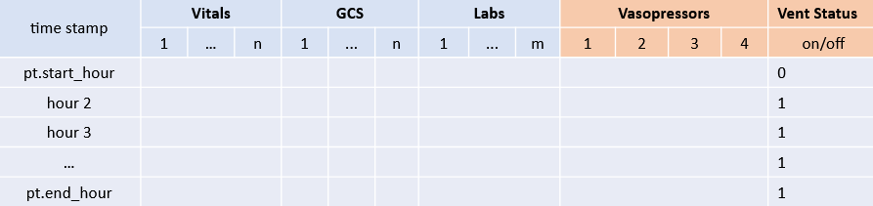
super_table: Vitals Columns
Need to Update
6/25
Super Table Col Name | Variable Type | Location | Example
temperature | (float) | [vitals]
weight_kg | (float) | [vitals]
height_cm | (float) | [vitals]
sbp_line | (int) | [vitals]
dbp_line | (int) | [vitals]
map_line | (float) | [vitals]
sbp_cuff | (int) | [vitals]
dbp_cuff | (int) | [vitals]
map_cuff | (float) | [vitals]
pulse | (int) | [vitals]
resp_rate | (int) | [vitals]
spo2 | (int) | [vitals]
end_tidal_co2 | (int) | [vitals]
o2_flow_rate | (int) | [vitals]
Description:
This is the list of columns needed in the super_table

Slide 20
gcs_staging (data frame)
Need to Update
6/25
Description:
gcs scores needed for SOFA calc and future models
Column Name | Variable Type | Location | Example
recorded_time | (timestamp) | [gcs]
flow_row_id | (float) | [gcs]
gcs_total_score | (float) | [gcs]
gcs_verbal_score | (float) | [gcs]
gcs_eye_score | (float) | [gcs]
gcs_motor_score | (float) | [gcs]

Slide 21
super_table: GCS Columns
Super Table Column Name | Variable Type | Location | Example
gcs_total_score | (float) | [gcs_staging]
gcs_verbal_score | (float) | [gcs_staging]
gcs_eye_score | (float) | [gcs_staging]
gcs_motor_score | (float) | [gcs_staging]
Description:
This is the list of columns needed in the super_table
Need to Update
6/25

Slide 22
labs_staging (data frame)
Need to Update
6/25
Description:
labs needed for SOFA calc and future models
Column Name | Variable Type | Location | Example
super_table_col_name | (str) | grouping_labs
collection_time | (timestamp) | [labs]
lab_result_time | (timestamp) | [labs]
proc_code | (str) | [labs]
proc_desc | (str) | [labs]
component_id | (big int) | [labs]
component | (str) | [labs]
loinc_code | (str) | [labs]
lab_result | (str) | [labs]

Slide 23
super_table: Lab Columns
Need to Update
6/25
Super Table Column Name | Variable Type | Location | Example
alkaline_phosphatase | (float) | [labs]
albumin | (float) | [labs]
ammonia | (float) | [labs]
amylase | (float) | [labs]
aspartate_aminotransferase_(ast) | (float) | [labs]
base_excess | (float) | [labs]
bicarb_(hco3) | (float) | [labs]
bilirubin,_indirect | (float) | [labs]
chloride | (float) | [labs]
creatinine | (float) | [labs]
fibrinogen | (float) | [labs]
fio2 | (float) | [labs]
glucose | (float) | [labs]
hematocrit | (float) | [labs]
hemoglobin | (float) | [labs]
lactic_acid | (float) | [labs]
magnesium | (float) | [labs]
bilirubin,_total | (float) | [labs]
bilirubin_direct | (float) | [labs]
blood_urea_nitrogen_(bun) | (float) | [labs]
b-type_natriuretic_peptide_(bnp) | (float) | [labs]
c_diff | (float) | [labs]
calcium | (float) | [labs]
calcium,_ionized | (float) | [labs]
Super Table Column Name | Variable Type | Location | Example
calcium_adjusted | (float) | [labs]
carboxy_hgb | (float) | [labs]
cortisol | (float) | [labs]
covid | (float) | [labs]
crp_high_sens | (float) | [labs]
d_dimer | (float) | [labs]
diff | (float) | [labs]
erythrocyte_sedimentation_rate_(esr) | (float) | [labs]
gfr | (float) | [labs]
hemoglobin_a1c | (float) | [labs]
inr | (float) | [labs]
lactate_dehydrogenase | (float) | [labs]
lipase | (float) | [labs]
partial_pressure_of_carbon_dioxide_(paco2) | (float) | [labs]
partial_pressure_of_oxygen_(pao2) | (float) | [labs]
partial_prothrombin_time_(ptt) | (float) | [labs]
ph | (float) | [labs]
phosphorus | (float) | [labs]
platelets | (float) | [labs]
potassium | (float) | [labs]
prealbumin | (float) | [labs]
procalcitonin | (float) | [labs]
saturation_of_oxygen_(sao2) | (float) | [labs]
troponin | (float) | [labs]
white_blood_cell_count | (float) | [labs]
Description:
This is the list of columns needed in the super_table
NEW: 12/16
12/17:
-Need to add ALT

Slide 24
vasopressor_staging (data frame)
Need to Update
6/25
Description:
vasopressor dosing needed for SOFA calc and future models
Column Name | Variable Type | Location | Example
super_table_col_name | (str) | grouping_vasopressor
med_order_time | (timestamp) | [infusion_meds]
med_action_time | (timestamp) | [infusion_meds]
med_start | (timestamp) | [infusion_meds]
med_stop | (timestamp) | [infusion_meds]
medication_id | (int) | [infusion_meds]
med_name | (str) | [infusion_meds]
med_action_code | (int) | [infusion_meds]
med_action | (str) | [infusion_meds]
med_action_dose | (float) | [infusion_meds]
med_action_dose_unit | (str) | [infusion_meds]
infusion_rate | (int) | [infusion_meds]
infusion_rate_unit | (str) | [infusion_meds]
therapeutic_class | (str) | [infusion_meds]
pharmacy_class | (str) | [infusion_meds]
pharmacy_subclass | (str) | [infusion_meds]

Slide 25
super_table: Vasopressor Columns
Need to Update
6/25
Super Table Column Name | Variable Type | Location | Example
epinephrine | (float) | [vasopressor_staging]
epinephrine_dose_unit | (str) | [vasopressor_staging] [med_action_dose_unit]
norepinephrine | (float) | [vasopressor_staging]
norepinephrine_dose_unit | (str) | [vasopressor_staging] [med_action_dose_unit]
dopamine | (float) | [vasopressor_staging]
dopamine_dose_unit | (str) | [vasopressor_staging] [med_action_dose_unit]
dobutatmine | (float) | [vasopressor_staging]
dobutamine_dose_unit | (str) | [vasopressor_staging] [med_action_dose_unit]
phenylephrine | (float) | [vasopressor_staging]
phenylephrine_dose_unit | (str) | [vasopressor_staging] [med_action_dose_unit]
vasopressin | (float) | [vasopressor_staging]
vasopressin_dose_unit | (str) | [vasopressor_staging] [med_action_dose_unit]
Description:
This is the list of columns needed in the super_table

Slide 26
vent_staging (data frame)
Need to Update
6/25
Description:
vent start/stop time needed for SOFA calc
vent_number (int) *auto gen | vent_start (timestamp) [vent] | vent_stop (timestamp) [vent]
1 | 2020-01-01 12:00:00 | 2020-01-01 12:00:00
2 | 2020-01-01 12:00:00 | 2020-01-01 12:00:00
CSJ: Add FiO2 cols
* field name: example value (type) [file name]

Slide 27
bed_location (data frame)
Need to Update
6/25
Column Name | Variable Type | Location | Example
bed_location_start | (timestamp) | [bed_locations]
bed_location_stop | (timestamp) | [bed_locations]
bed_unit | (str) | [bed_locations]
bed_room | (str) | [bed_locations]
bed_id | (str) | [bed_locations]
bed_label | (str) | [bed_locations]
hospital_service | (str) | [bed_locations]

Slide 28
diagnosis (data frame)
Need to Update
6/25
Column Name | Variable Type | Location | Example
dx_line | (int) | [diagnoses]
dx_icd_scope | (str) | [diagnoses]
dx_code_icd9 | (str) | [diagnoses]
dx_code_icd10 | (str) | [diagnoses]
dx_source | (str) | [diagnoses]
dx_time_date | (timestamp) | [diagnoses]
dx_code | (str) | [diagnoses]
dx_name | (str) | [diagnoses]

Slide 29
procedures (data frame)
Need to Update
6/25
Column Name | Variable Type | Location | Example
log_id | (bigint) | [or_procedures]
surgery_date | (timestamp) | [or_procedures]
in_or_dttm | (timestamp) | [or_procedures]
procedure_start_dttm | (timestamp) | [or_procedures]
procedure_comp_dttm | (timestamp) | [or_procedures]
out_or_dttm | (timestamp) | [or_procedures]
or_proc_id | (int) | [or_procedures]
cpt_code | (int) | [or_procedures]
primary_procedure_nm | (str) | [or_procedures]
service_nm | (str) | [or_procedures]
primary_physician_nm | (str) | [or_procedures]
asa_rating_cd | (int) | [or_procedures]
asa_rating | (str) | [or_procedures]
wound_class_c | (int) | [or_procedures]
surgical_wound_class | (str) | [or_procedures]
* field name: example value (type) [file name]

Slide 30
Grady Data Notes
Need to Update
6/25
Data Element | Remark | Recommendation
mrn/pat_id | Unique to pt (i.e. one per patient) | USE MRN
csn/har | Unique to the encounter (i.e. one per encounter) | USE CSN

Slide 31
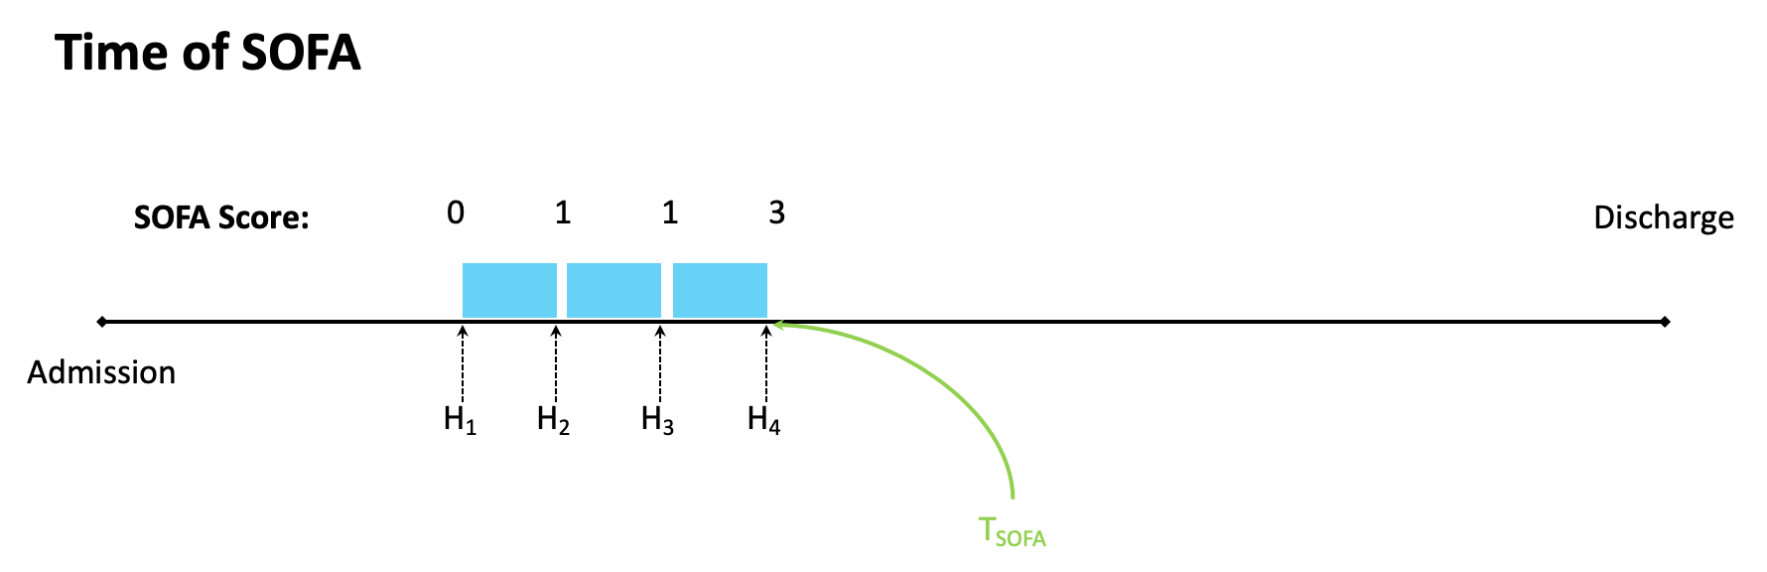
T_{SOFA} - Time When SOFA score >2

Slide 32
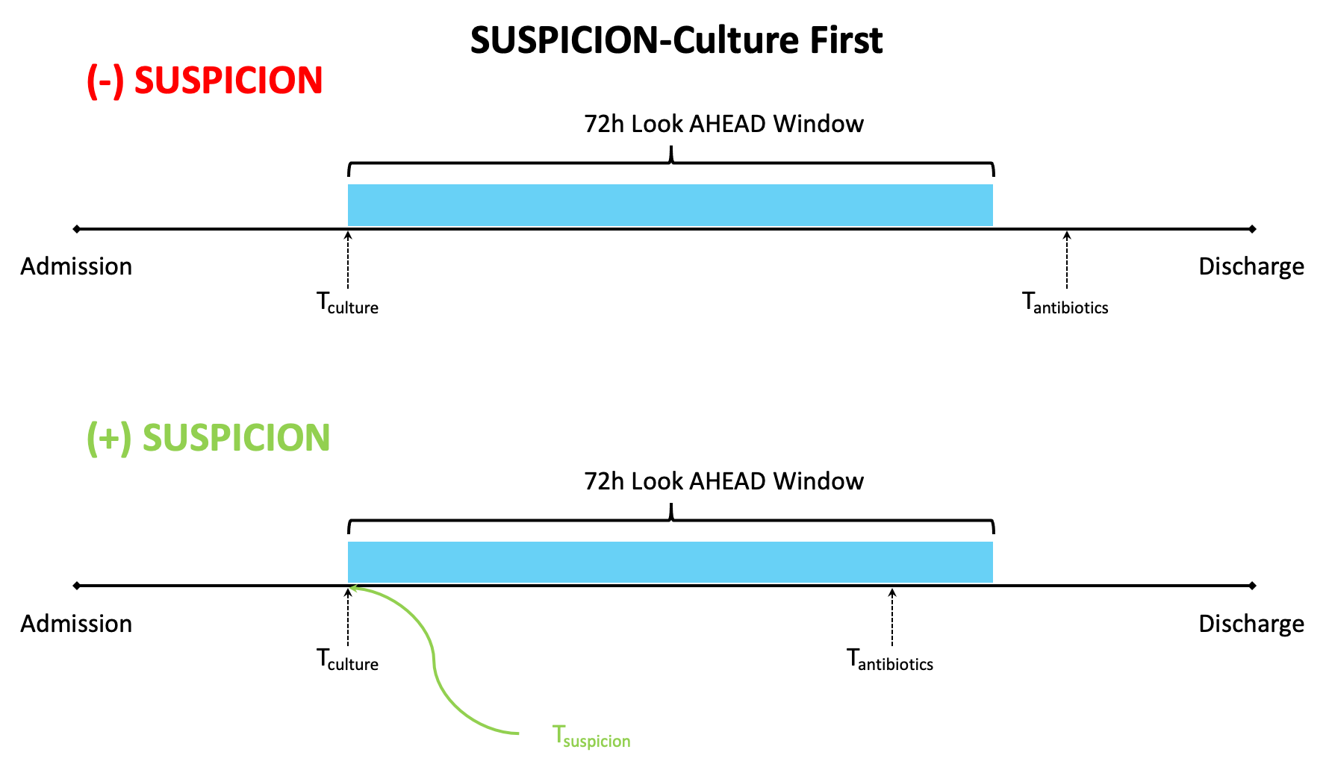
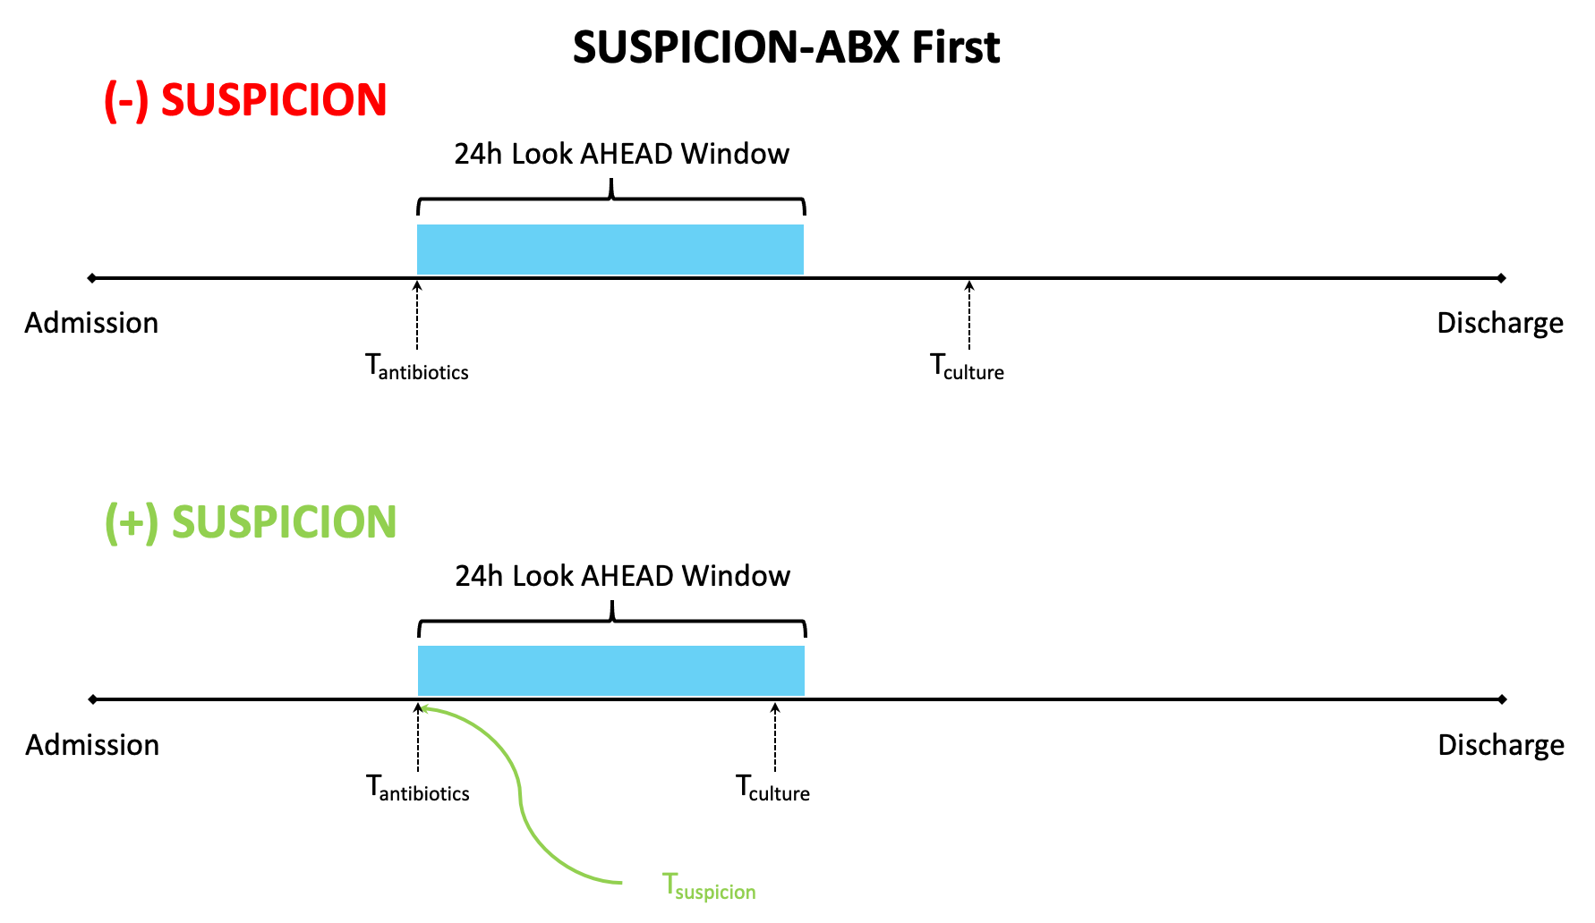
T_{suspicion} - Culture + Abx
The earlier of Antibiotics or Cultures in a certain time span:
If Cultures first then antibiotics within 72hrs
If Antibiotics then cultures within 24hrs

Slide 33
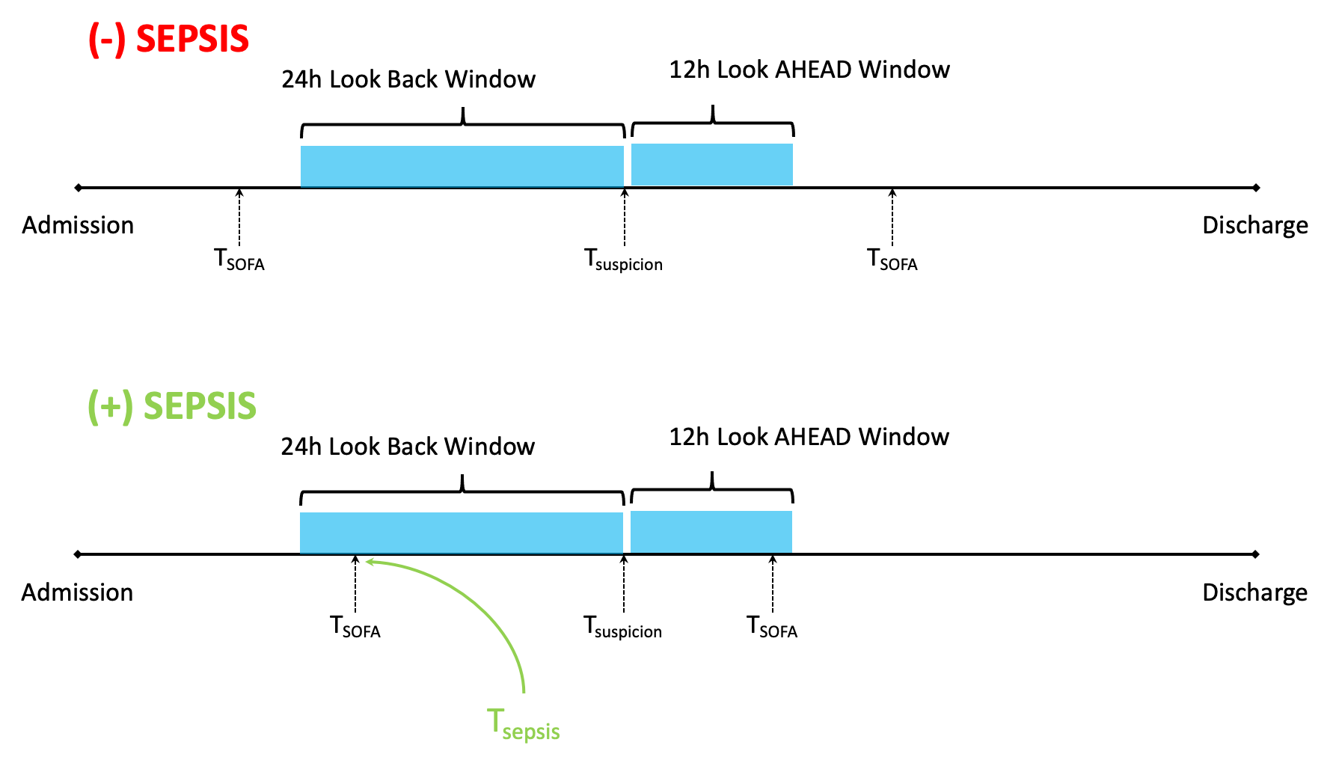
T_{sepsis} - Official Time of Sepsis
Episode of Tsuspicion + 2pt chang in sofa
-24hrs before Tsuspicion
-12hrs after Tsuspicion

Slide 34
CSJ To Do
What happens to lab values w/ ‘collection_time’ = NULL?
? Should use ‘lab_result_time’
Antibiotic names if not given pharm class
SOFA resp needs pf_sa calcs and selection
SOFA-max
?Is there a gap between end of last window and discharge time?
Need to identify ICU beds and ICU status

Slide 35
OPERATIONS
Tools, Techniques, Software for BMI Cluster Ops

Slide 36
BMI Cluster
Odd Jobs- Landing point after SSH into BMI cluster; you can do some basic Linux functions here, but you can’t run code. This is where you execute a SLURM command to request resources.
oddjobs is sort of like the front desk of a hotel; you go to the desk to ask for a room (resource). You describe your room (resource) in terms of number of processors, RAM, and time.

Slide 37
Big Edge IP Client
To Do

Slide 38
SSH
SSH Command | What it does | Notes
ssh cjosef@oddjobs.bmi.emory.edu | logs cjosef into oddjobs via ssh
ssh cjosef@nematilab2.bmi.emory.edu | logs cjosef into nematilab2 | You might not have permission to access NL2 You can see the lab directory from NL2, but you can’t see your normal home directory (i.e. your home directory is on NL2)
ssh -t cjosef@oddjobs.bmi.emory.edu ssh cjosef@nematilab3.priv.bmi.emory.edu | logs cjosef into nematilab3 via oddjobs; this is sometimes called a hop | You might not have permission to access NL2 NL3 is hidden from the public; you have to hop to NL3 from a computer on the network (usually oddjobs)
ssh -N -f -L localhost:8888:localhost:8899 cjosef@nematilab2.bmi.emory.edu | Forwards port 8888 on NL2 to your home computer port of 8899 | Once you spin up a jupyter NB server the web GUI can be access via your home browser without additional configuration. (much better than X2go) You have to run this command in its own shell session; it’ll look like it’s doing nothing once you run it, but that’s normal. If this shell loses its connection Jupyter will stop working on your home browser, but it could still be running on NL2.

Slide 39
Virtual Environment (1/3)
Background
There are two versions of python available on the cluster:
Python 2.7.5 This is used for basic computer functions
Python 3.6.3 This is used for elite data hacking
These preinstalled versions of python come with very few (almost zero) additional libraries. You need to build a “virtual environment”. A venv will point to one of the (2) python versions on the cluster and then will use all the libraries you have installed. You can share a venv with collaborator to ensure that all parties are using the same packages and versions.
Web Resources
https://virtualenv.pypa.io/en/latest/
https://docs.python.org/3/library/venv.html
NOTES:
vevn != virtualenv (venv is the native python tool (virtualenv can do more) but we use venv)
If two people use the same venv at the same time it can cause errors/conflicts, so it’s best to make your own venv

Slide 40
Virtual Environment (2/3)
Build a Virtual Environment
Command | Virtual Environment Step Description | Notes
scl enable rh-python36 bash | Switch from using python 2.7.5 to 3.6.9 | All sessions default to 2.7.5 so you have to do this for each session. If your SSH session terminates you’ll go back to 2.7.5
mkdir Environments | You need a place for your virtual environment files to live; you can use your home directory or a lab directory if you’re sharing the VE with collaborators
python3 -m venv Environments/SOFA_calcs | This command takes a couple of minutes and will make a VE in folder Environments called “SOFA_calcs
source /labs/kamaleswaranlab/MODS/Environments/SOFA_calcs/bin/activate | This activates your VE; you should see the name of your VE next to your user name on the bash command line
pip3 install --upgrade pip pip3 install --upgrade jupyter numpy scipy matplotlib pandas seaborn pathlib scikit-learn | Pip is a common tool for installing new libraries/packages; | Your VE must be active for PIP to work. If not you’ll get an error I have listed some simple python packages, but you can/should add more as you need them Separate packages/libraries with a space
NOTE: venv creation should work with python or python3 but there seems to be less issues using python3

Slide 41
Virtual Environment (3/3)
Other VE Commands
Command | Virtual Environment Step Description | Notes
pip3 freeze --local > requirements.txt | Save a list of libraries in your environment to a file named “requirements.txt” | You can share this list with a collaborator so that everyone is using the same packages/versions
pip3 install -r requirements.txt | This reads the file you made above and installs all the packages listed in the file
deactivate | This stops your VE and takes you back to a regular bash session
rm -rf /Environment/SOFA_calcs/ | Hate your VE? Then delete it. Make a new one. There are a lot of files so it might take a while
virtualenv -p /usr/bin/python2.6 py26_env | Working somewhere else (i.e. home computer) and want to specify a python version? Then use this command

Slide 42
Jupyter: Port Fwd
Command | Jupyter Command Description | Notes
source /labs/kamaleswaranlab/MODS/Environments/SOFA_calcs/bin/activate | Activates your venv with jupyter library installed | If your venv is already running then this step is not needed
jupyter notebook --no-browser --port=8899 | Stands up a jupyter notebook server that shares info on port “8899” | If you do not execute this command from inside of “screen” then the server will not persist after your ssh connection is broken
ssh -N -f -L localhost:8888:localhost:8899 cjosef@nematilab2.bmi.emory.edu | Forwards the jupyter server running in BMI on port “8899” to your home computer’s port “8888” | Must be done in a new terminal window
localhost:8888 | Address you type in your local home browser to see jupyter notebook webpage
jupyter notebook list | Displays list of currently running jupyter notebooks

Slide 43
Jupyter X2GO (1/2)
Instructions on Terminal:
1. Open a terminal window and connect to Oddjobs via SSH. Use the following command:
ssh username@oddjobs.bmi.emory.edu
(Enter your password on Terminal after running this command)
2. From Oddjobs, start an interactive session on the cluster using the srun command (srun <your_resource_request_parameters> --pty bash -i). You can use the following command: srun -J MyTestJob -p batch -n 1 --mem 1G -t 4:0:0 --pty bash -i
a. You can edit the memory or time required for the job you’d like to accomplish.
3. Once the interactive session starts (note that the command prompt will change to indicate the node you're now running on, assuming that you've not customized your Bash profile to remove the system hostname from the prompt), run the following command to start a Jupyter Notebook session: scl enable rh-python36 'jupyter notebook’
a. If you need to do some extra setup before starting the notebook, you can either
script it and call the script in the above command instead, or use scl enable rh-python36 bash to start a shell in the SCL Python 3.6 environment and run your additional commands from there.
4. When the Jupyter Notebook starts up it will give you the URL to copy into a browser to reach it. This URL is only reachable from within BMI's internal network. You will paste this URL into the address bar in a Firefox session on Nebula. This will allow you to
navigate to the Jupyter Notebook’s interface. To get there, follow the X2Go instructions.

Slide 44
Jupyter X2GO (2/2)
Instructions on X2Go:
1. Install the software X2Go at: https://wiki.x2go.org/doku.php
a. If you’re on a Mac, you may have to also download XQuartz at: https://www.xquartz.org/.
2. Create a new session to connect to Nebula with the “Session type” of “XFCE.” If
necessary, you can modify the settings on the other tabs to match your preferences and
your network/Internet environment.
a. Make the host as “nebula.bmi.emory.edu” and the SSH port as “22.”
3. Press the area labeled “Nebula” on the X2Go window, where the session type of “XFCE”
is visible. Then, login with your Emory email address (username@emory.edu) and
password.
4. X2Go should pop up a place where you can select sessions. There may be a list of
sessions that say “suspended” or “running.” Press “new” if this is your first time opening
X2Go. Otherwise, you can resume a previous session by pressing the “running” session.
Once you press a session, this should open up a new window with a blank screen and a
taskbar at the bottom.
5. Press the Firefox button on the toolbar to open a browser. The button looks like an Earth
with a computer mouse on it. Then, paste the URL from the Terminal into the browser.
a. If Firefox denies access and says that a previous session is running, you must
either terminate the other sessions that say “running” or instead click on the
“running” session to access Jupyter Notebook.
6. Once you are completely done with your Jupyter Notebook session, you can then stop
the Jupyter Notebook server via the button on the web interface and end your
interactive session on the cluster by using the exit command at the command prompt.
Otherwise, you can just close the browser or X2Go window and then reconnect to your
Jupyter session later as long as it's still running on the cluster.

Slide 45
Screen
Screen Function | command
create a named session | screen -S [session_name]
detach | screen -d
resume | screen -r
list screens | screen -ls
kill screen | screen -X -S [scr num] quit
To Do
https://linuxize.com/post/how-to-use-linux-screen/

Slide 46
SLURM
Slurm Function | command
# Show the overall status of each partition | sinfo
# Submit a job | sbatch .jobs/jobFile.job
# See the entire job queue | squeue
# See only jobs for a given user | squeue -u username
# Count number of running / in queue jobs | squeue -u username | wc -l
# Get estimated start times for your jobs (when Sherlock is busy) | squeue --start -u username
# Show the status of a currently running job | sstat -j jobID
# Show the final status of a finished job | sacct -j jobID
# Kill a job with ID $PID | scancel $PID
# Kill ALL jobs for a user | scancel -u username
# Kill all pending jobs | scancel -u username --state=pending
# Run interactive node with 16 cores (12 plus all memory on 1 node) for 4 hours: | srun -n 12 -N 1 --mem=64000 --time 4:0:0 --pty bash
#Claim interactive node for exclusive use, 8 hours | srun --exclusive --time 8:0:0 --pty bash
# Same as above, but with X11 forwarding | srun --exclusive --time 8:0:0 --x11 --pty bash
# Same as above, but with priority over your other jobs | srun --nice=9999 --exclusive --time 8:0:0 --x11 --pty -p dev -t 12:00 bash
# Check utilization of group allocation | sacct
# Running jobs in the group allocation | srun -p groupid sbatch -p groupid
# Stop/restart jobs interactively # To stop: | scancel -s SIGSTOP job id
# To restart (this won't free up memory): | scancel -s SIGCONT job id
# Get usage for file systems | df -k df -h $HOME
# Get usage for your home directory | du
# Checking Disk Quota | lfs quota -u <sunetid> -h /scratch/ lfs quota -g <pi_sunetid> -h /scratch/
# Counting Files | find . -type f | wc -l
To Do

Slide 47
END

Slide 48
Filters:
filter_cohort
applies inclusion & exclusion criteria to create cohort
SELECT discharge_status, discharge_to, count(*) FROM grady2.encounters group by discharge_status, discharge_to;

Slide 49
Grouping:
grouping_labs
Review Lab grouping and determine what needs updating
SQL code
grouping_cx_pos
Review Cx grouping and determine what is positive
SQL code
grouping_cx_neg
Review Cx grouping and determine what is neg
SQL code
grouping_abx
Review anti-infection medications and determine which to keep for Abx list
SQL code
grouping_vasopressor
Review Vasopressor list and determine which to keep for Abx List
SQL code

Slide 50
Discussion Points
Should CSN be included in the dictionary with each result?
Yes

Slide 51
encounters
ed_arrival_source
Self Referral | 1046249
Physician or Clinic Referral | 26453
NULL | 432
"Court/Law Enforcement" | 353
Psych, Substance Abuse, or Rehab Hospital | 4496
Outside Hospital | 4794
Ambulatory Surgery Center | 366
Newborn-Born Inside Hospital | 18477
Newborn-Born Outside Hospital | 105
Outside Health Care Facility | 221
Skilled Nursing Facility | 75
Hospice | 1215
Emergency OP Unit | 1

Slide 52
Notes:
11/18
CSN will complete all rows in dictionary not in grey
CSJ will provide lab, vasopressor, and antibiotic groupings
11/20
static feature dictionary working, event_times working
CSJ check MRN = pt_id
Double check Inpt vs Emergency status
CSJ needs to finish vasopressor filter by friday noon
CSJ needs to finish lab columns by Saturday afternoon
CSJ by monday finish the rest of the dictionary structure
SM will do V2LA vitals, labs, vent (By Wed)
SM add ABX df, vassopressor df based on filters, may try to do V2LA abx 1/0 (By Wed)
11/23
add structure for new df’s for vitals, vent, labs, vasopessor, abx
describe how we’d translate V2LA into a physionet format
SM will prepare a prelim V2LA with vitals and labs
SM work on sharing jupyter nb (low priority)
11/25
hourly vitals
import all the staging tables
migrate over to emory one drive
11/30
SN: start: admission time, end: discharge time (consider mins as well)
SN: supertable (concat vital, lab, vent, ...)
SN: functions and load in the jupyter
SN: add options for multiple recording in an hour, (mean, median, last, ...)
12/4
import list of patient comorbidities
CSJ-Spot check vitals, labs, abx for 5x pts
*SM- move labs over to super_table
SM- make class for data_import
SM- look at GCS calculation
SM- work on changing to a more recent year (i.e. 2017) (low importance)
SM- add bed location data to super table (med importance)
CSJ- make class for data_clean

Slide 53
Notes:
1/4
Updated these pt_dictionary keys:
Vent_status (make all lower case)
Abx_staging (make all lower case)
GCS_staging (make all lower case)
vssopressors_staging -> vasopressor_staging (drop “s”)
12/11
GCS Bug #1
Add cuff SBP, DBP, MAP to super_table
CSJ finishes SOFA calcs
CSJ finish SOFA class & Cleaning Class
CSJ finishes 5pt review
SN complete Suspicion calcs
Share the class file
12/16
Add files for the following 2014 CSNs: [1008538920, 1009248962, 1008838693, 1012890869, 1008736689, 1009578945, 1012320650, 1009808181, 1011947802, 1012813550]
Need to add col with vasopressor dose_unt
*** grouping file-> “v2la_col_name” is now “super_table_col_name”
12/21
? Set datetime for those cols
12/30
Will create 200 pickles for local dev (i.e. one drive)
Will attempt to run 1,000 CSNs on BMI cluster
Finish Vasopressor and Fio2
CSJ- Update ppt for Diagnosis and Op_times
SN- Import Diagnosis and OP times based on ppt
CSJ- set up meeting with Gari

Slide 54
Bug Tracker
Bug # | PT CSN | Dictionary Item | Prob description | Status
1 | 1012101368 | GCS | Is missing GCS scores at: 2014-09-17 23:00:00 2014-09-18 08:00:00 2014-09-18 23:00:00 | Corrected 12/14/20- all GCS are showing up
2 | 1012137247 | “super_table” | Remove the following columns from super table: “diff” “recorded_time” (from gcs staging) “flo_row_id” (from gcs staging) “other” (from vasopressor_staging) | Corrected 12/28/20
3 | 1012137247 | “super_table” | There is a comma in column named: “bilirubin,_total” “calcium,_ionized” “bilirubin,_indirect” (Lab grouping file updated- 12/16/20) | Corrected 12/17/20
4 | 1012137247 | “super_table” | The following cols are missing: “sbp_cuff” “dbp_cuff” “map_cuff” | Corrected 12/17/20
5 | 1012137247 | “super_table” | Change “Status” to “vent_status” | Corrected 12/17/20
6 | 1008538920 | “super_table” | Only a single value is appearing across vasopressors | Update made; new bug described in Bug #8
7 |  | “bed_location” | Mutliple bed locations per single time

Slide 55
Bug Tracker
Bug # | PT CSN | Dictionary Item | Prob description | Status
8a | 1009578945 | super_table | 1) Is missing all ephinephrine doses, but should have multiple: 2014-06-24 02:00:00 2014-06-24 04:00:00 2014-06-24 06:00:00 2) Is missing many norepinephrine doses, should have >15 but only two ar recorded. 3) Is missing all phenylephrine doses; should have ones at : 2014-06-24 11:00:00 2014-06-25 05:00:00 4) Is missing some vasopressin infusions; should have some at: 2014-06-24 02:00:00 2014-06-24 08:00:00 2014-06-24 11:00:00 | Added: 12/28
8b | 1012320650 | super_table | No vasopressors listed - should have had norepinephrine at: 2014-10-16 15:00:00
9 | '1008384225' | Vent | Has fio2 but is not listed as being on vent; SQL says no start/stop; check Epic record

